Slide 1

Journey to the Center of the Earth Project
Jules Verne Travel – Department of Technology
Fabiana Mansueto Silva – April 2018

Slide 2
Vision
Jules Verne Travel is the go-to travel agency for Extraordinary Voyagers.
Our goal is to build strong relationships with clients, scientists and entrepreneurs through proper management of fantastic travels such as Journey to the Center of the Earth.
The development of geological mineralogy is one of the many positive consequences of our work.
The future travels are From the Earth to the Moon and Twenty Thousand Leagues Under the Sea.

Slide 3
What are we selling?
The Jules Verne Travel is selling a “Journey to the Center of the Earth”. It is an extraordinary voyage to the interior of the Earth through volcanic tubes.
The principal tourist attractions are prehistoric animals, giant crystal caves, plenty of the amazing colours and rock formations that exist inside a volcano.

Slide 4
Website Concepts
While there are a lot of important components to effective website design, including these four key elements can make a difference:
Simple navigation
Search
Buttons
Excellent Images
The Website can be accessed by mobile, tablet, notebook, and desktop.
The colours reflect the identity of the Jules Verne Travel Logo.

Slide 5
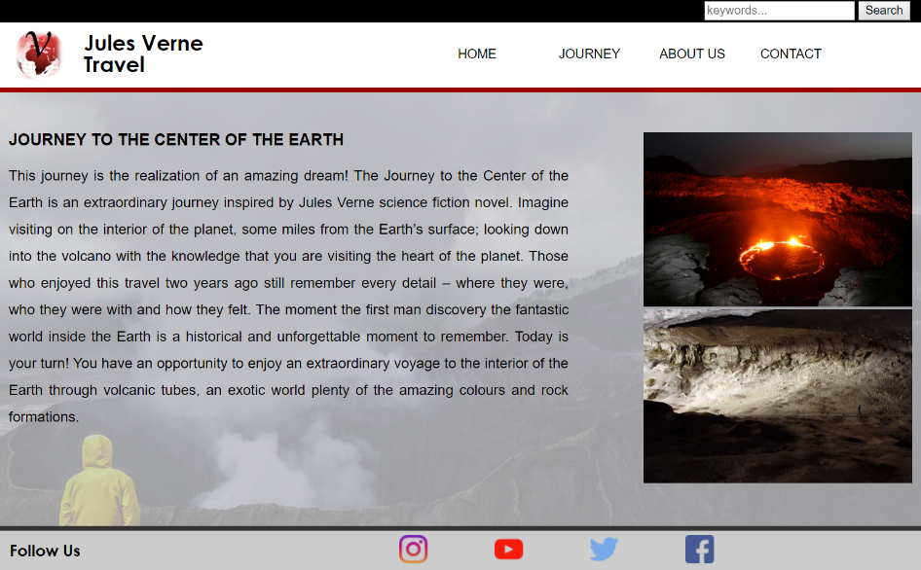
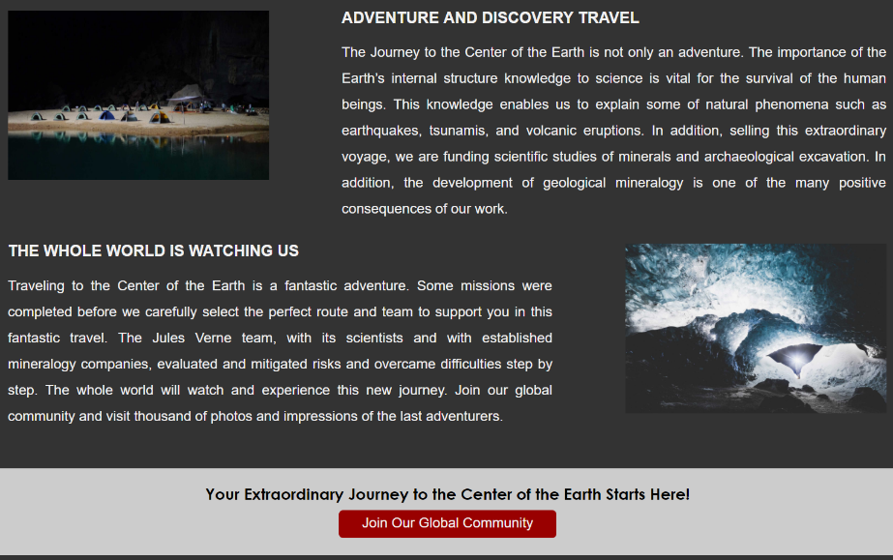
Home Page
The Home Page of the Website includes information about the journey, connection, and marketing elements.
1
2
3

Slide 6
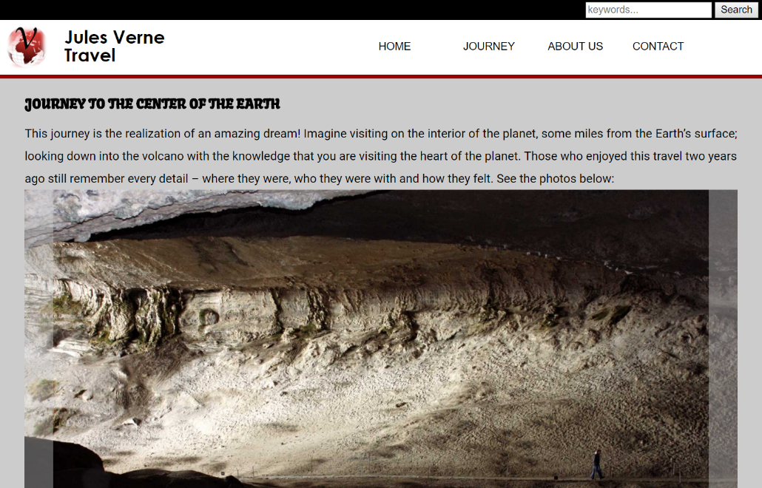
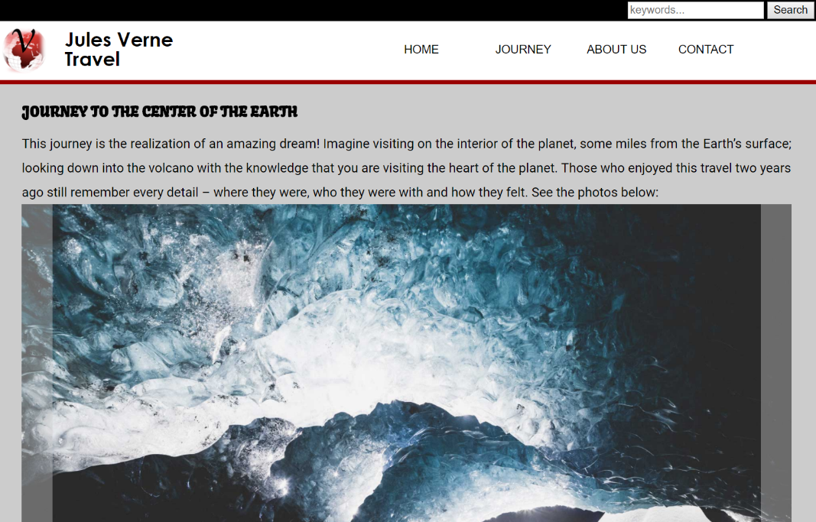
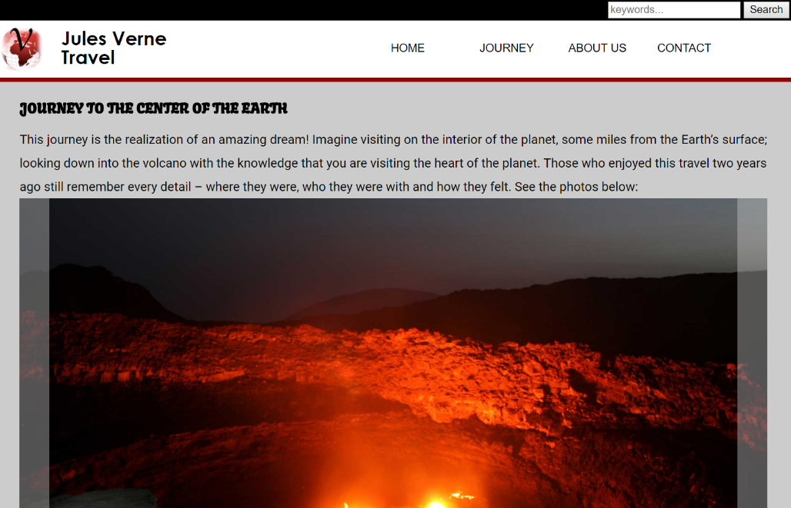
Journey Page
The Journey Page of the Website describes details of the first journey to the interior of the Earth through volcanic tubes.
Slide Show - Presentation

Slide 7
Common Elements
Simple and easy to fill:
first consumer contact.

Slide 8
Common Elements
There are a few common elements every page include.
1
2
3

Slide 9
Slide Show
Glossary & Concepts
A slide show is a presentation of a series of still images on a projection screen or electronic display device, typically in a prearranged sequence. The changes may be automatic and at regular intervals or they may be manually controlled by a presenter or the viewer.
Marketing Elements
The marketing elements refers to the set of actions, or tactics, that a company uses to promote its brand or product in the market.

